Slide 1

AI/ML Project
Covid-19/Breast- Cancer/Alzheimer prediction
Team - 2

Slide 2

TEAM MEMBERS
20190802140
20190802063
Ashwin Jawalikar
Maitri Surve
Aakriti Singh
Krutika Deolapure
Priyansh Bakhtani
20190802006
20190802054
20190802079

Slide 3

Introduction
Coronavirus disease is an infectious disease caused by the sars-cov-2 virus.
Breast cancer is a disease in which cells in the breast grow out of control. A tumour can be benign or malignant. Benign are not cancerous tumors and Malignant are cancerous tumors.
Alzheimer’s disease is a neurodegenerative disorder that affects the brain. The symptoms are mild at first and become more severe over time.

Slide 4
PROJECT OVERVIEW
Disease Prediction System (DPS) is based on the Data Science And Aiml techniques which makes use of for predicting the risk level of diseases i.e. Breast Cancer, Covid-19 and Alzheimer Based on their symptoms and some reports.
The Covid-19 prediction uses 15 responses including some symptoms and several questions to predict the chances of the disease.
The breast cancer prediction is based on the measurements of the tumor.
The Alzheimer’s disease prediction uses MRI scans of a patient's brain to determine the severity of the patient’s Dementia.

Slide 5

MACHINE LEARNING ALGORITHMS
Supervised
Unsupervised
COVID-19 (Decision Tree Classifier),
Breast Cancer (Random Forest Classifier)
Alzheimer’s Disease (Convolutional Neural Network)

Slide 6
ARCHITECTURE FOR COVID-19 & BREAST CANCER PREDICTION
1.
2.
3.
4.
5.
Exploratory Data analysis
Using Decision tree(Covid) /Random forest (Breast Cancer) to train the model with training data.
Split the dataset to training data and testing data.
Test and validate the model with the test data.
Compare the accuracy of the models.

Slide 7
Tested Algorithms
Decision Tree
SVM
K Nearest Neighbors
Logistic Regression
GaussianNB
Random Forest

Slide 8
Covid-19
EDA
Finding Unique Values
Checking for missing
values
Label Encoding
Feature importance

Slide 9
Decision Tree Classifier
uses a set of rules to make decisions
perform both classification and regression tasks
splits the dataset based on the value of a column, and creates new nodes
visualize the model

Slide 10
Breast Cancer EDA
Feature encoding
Check Correlation
Dropping dependent variable
Feature Scaling

Slide 11
Random Forest
Classifier
Can be used for both Classification and Regression problems
Combines multiple classifiers to solve a complex problem
Enhances the accuracy of the model

Slide 12
Alzheimer Disease - Convolutional Neural Network
Scaling and image preprocessing
Convolution and Pooling layers extract features and create smaller images
Identifies said features in test images after going through model
Input preprocessed images
Model extracts features to find
Finds aforementioned features in test images
Notes:
Ashwin

Slide 13
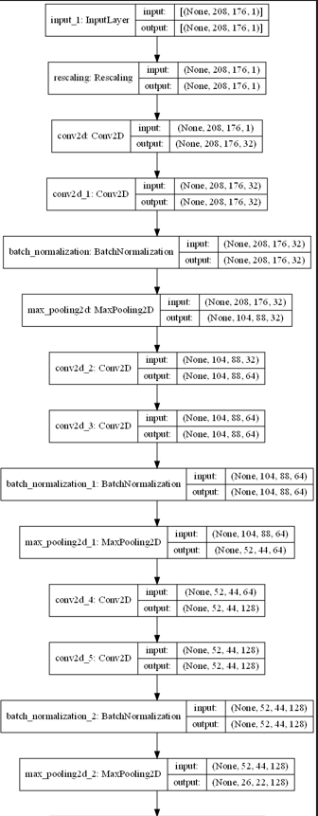
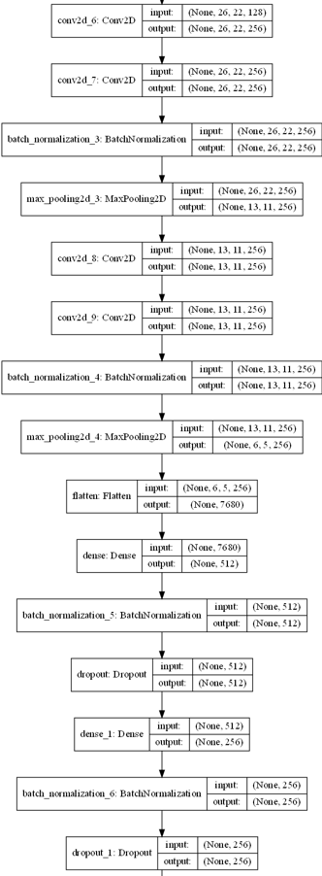
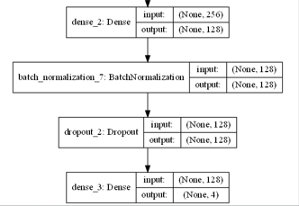

Slide 14
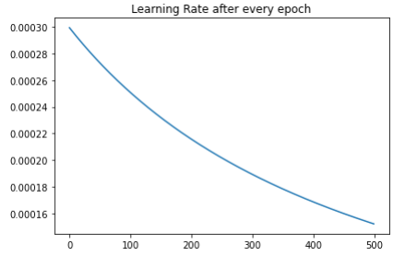
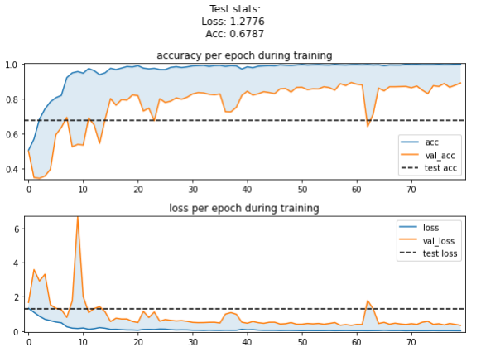
Training and testing performance
Used variable learning rate that decreases by 5% after every epoch
Training performance every epoch and final testing performance

Slide 15

THANKS!

